Slide 1
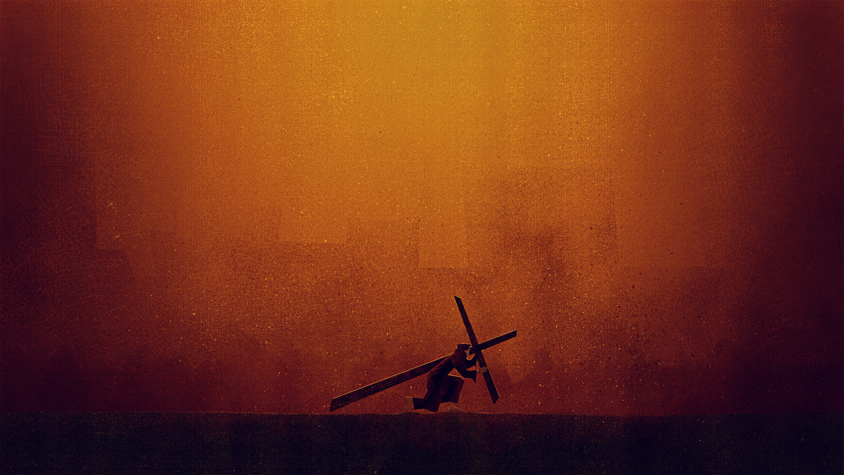
Journey To The
North Heights
Church of Christ
11710 S. Memorial Dr., Bixby, OK
(918) 369-5810
www.northheights.org
Follow us on Facebook
Cross
Jesus Knows About:
Being Betrayed (Wed. March 28th, 7pm) Being Tempted (Thur. March 29th, 7pm) Feeling Alone (Fri. March 30th, 7pm) Facing Death (Sat. March 31st, 5pm) Forgiveness (Sun. April 1st , 9:45am) Overcoming (Sun. April 1st , 10:45am)

Slide 2
When Jesus had spoken these words, He went out with His disciples over the Brook Kidron, where there was a garden, which He and His disciples entered. 2 And Judas, who betrayed Him, also knew the place; for Jesus often met there with His disciples. 3 Then Judas, having received a detachment of troops, and officers from the chief priests and Pharisees, came there with lanterns, torches, and weapons. 4 Jesus therefore, knowing all things that would come upon Him, went forward and said to them, “Whom are you seeking?”
Scripture Reading
John 18:1-11 (NKJV)

Slide 3
5 They answered Him, “Jesus of Nazareth.”
Jesus said to them, “I am He.” And Judas, who betrayed Him, also stood with them. 6 Now when He said to them, “I am He,” they drew back and fell to the ground.
7 Then He asked them again, “Whom are you seeking?”
And they said, “Jesus of Nazareth.”
8 Jesus answered, “I have told you that I am He. Therefore, if you seek Me, let these go their way,”
Scripture Reading
John 18:1-11 (NKJV)

Slide 4
9 that the saying might be fulfilled which He spoke, “Of those whom You gave Me I have lost none.”
10 Then Simon Peter, having a sword, drew it and struck the high priest’s servant, and cut off his right ear. The servant’s name was Malchus.
11 So Jesus said to Peter, “Put your sword into the sheath. Shall I not drink the cup which My Father has given Me?”
Scripture Reading
John 18:1-11 (NKJV)

Slide 6
12 Then the detachment of troops and the captain and the officers of the Jews arrested Jesus and bound Him. 13 And they led Him away to Annas first, for he was the father-in-law of Caiaphas who was high priest that year. 14 Now it was Caiaphas who advised the Jews that it was expedient that one man should die for the people… 19 The high priest then asked Jesus about His disciples and His doctrine.20 Jesus answered him, “I spoke openly to the world. I always taught in synagogues and in the temple, where the Jews always meet, and in secret I have said nothing.
Scripture Reading
John 18:12-14, 19-24 (NKJV)

Slide 7
21 Why do you ask Me? Ask those who have heard Me what I said to them. Indeed they know what I said.”
22 And when He had said these things, one of the officers who stood by struck Jesus with the palm of his hand, saying, “Do You answer the high priest like that?”
23 Jesus answered him, “If I have spoken evil, bear witness of the evil; but if well, why do you strike Me?”
24 Then Annas sent Him bound to Caiaphas the high priest.
Scripture Reading
John 18:12-24 (NKJV)

Slide 9
28 Then they led Jesus from Caiaphas to the Praetorium, and it was early morning. But they themselves did not go into the Praetorium, lest they should be defiled, but that they might eat the Passover. 29 Pilate then went out to them and said, “What accusation do you bring against this Man?”
30 They answered and said to him, “If He were not an evildoer, we would not have delivered Him up to you.”
Scripture Reading
John 18:28-40 (NKJV)

Slide 10
31 Then Pilate said to them, “You take Him and judge Him according to your law.”
Therefore the Jews said to him, “It is not lawful for us to put anyone to death,” 32 that the saying of Jesus might be fulfilled which He spoke, signifying by what death He would die.
33 Then Pilate entered the Praetorium again, called Jesus, and said to Him, “Are You the King of the Jews?”
Scripture Reading
John 18:28-40 (NKJV)

Slide 11
34 Jesus answered him, “Are you speaking for yourself about this, or did others tell you this concerning Me?”
35 Pilate answered, “Am I a Jew? Your own nation and the chief priests have delivered You to me. What have You done?”
36 Jesus answered, “My kingdom is not of this world. If My kingdom were of this world, My servants would fight, so that I should not be delivered to the Jews; but now My kingdom is not from here.”
Scripture Reading
John 18:28-40 (NKJV)

Slide 12
37 Pilate therefore said to Him, “Are You a king then?”
Jesus answered, “You say rightly that I am a king. For this cause I was born, and for this cause I have come into the world, that I should bear witness to the truth. Everyone who is of the truth hears My voice.”
38 Pilate said to Him, “What is truth?” And when he had said this, he went out again to the Jews, and said to them, “I find no fault in Him at all.
Scripture Reading
John 18:28-40 (NKJV)

Slide 13
39 “But you have a custom that I should release someone to you at the Passover. Do you therefore want me to release to you the King of the Jews?”
40 Then they all cried again, saying, “Not this Man, but Barabbas!” Now Barabbas was a robber.
Scripture Reading
John 18:28-40 (NKJV)

Slide 15
14 Seeing then that we have a great High Priest who has passed through the heavens, Jesus the Son of God, let us hold fast our confession. 15 For we do not have a High Priest who cannot sympathize with our weaknesses, but was in all points tempted as we are, yet without sin. 16 Let us therefore come boldly to the throne of grace, that we may obtain mercy and find grace to help in time of need.
Scripture Reading
Hebrews 4:14-16 (NKJV)

Slide 16
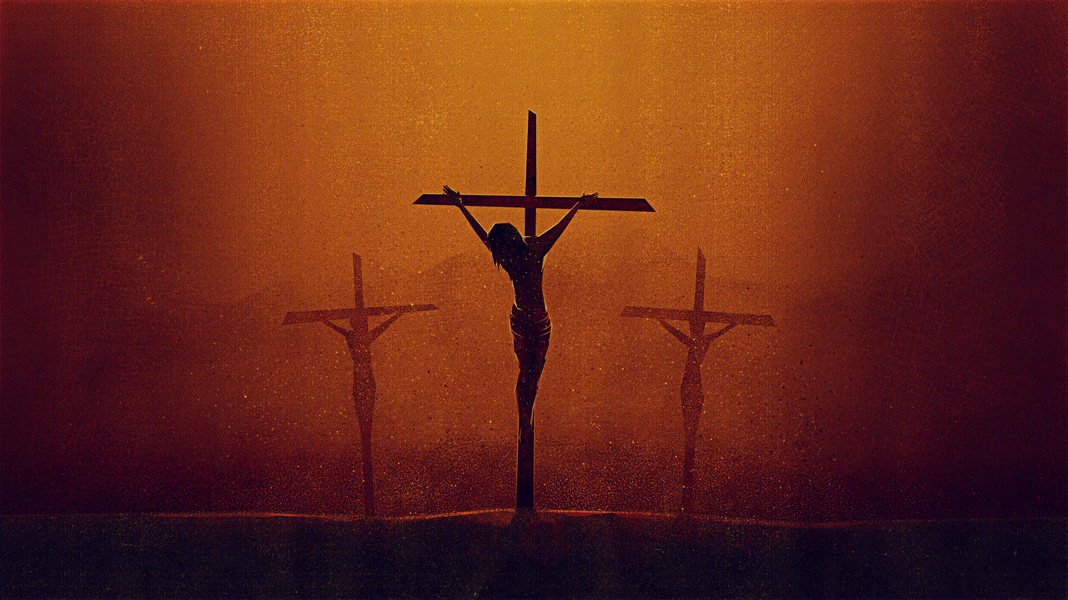
DIED
“…suffered under Pontius Pilate, was crucified, died, and was buried…”

Slide 17
American Culture Ideas
“Go your own way…” – have much more to say about how to celebrate and do life than deal with the reality of death.
“Glad that works for you…”
“I’m done with that…it doesn’t seem to help me”
“I want to be buried riding my motorcycle” (OH)
“I want to be kept frozen in case they find a cure”
“I will never see my daughter again” (Fl. Shooting)

Slide 18
Jesus Knows About: Facing Death
By taking on flesh he was going to die. (Heb. 9:27-28; Jn. 18:11)
Jesus drew near to the Father (Mt. 26:36-46)
Being ready to face death is living for God (Mt. 6:33, Lk. 2:49, John 9:4)
Being faithful unto death (John 17:4, 19:30; 1 Cor. 15:58, Rev. 2:10)
What will your last words be? (Lk. 23:46, Ps. 31:5)
Death is not the end (Lk. 23:46, Phil. 1:21)
Love triumphs over evil (Lk. 23:34; Mt. 6:12, 14-15; Rom. 12:21)
Love others to your last breath (John 19:26-27)

Slide 19
So then Pilate took Jesus and scourged Him. 2 And the soldiers twisted a crown of thorns and put it on His head, and they put on Him a purple robe. 3 Then they said, “Hail, King of the Jews!” And they struck Him with their hands.
4 Pilate then went out again, and said to them, “Behold, I am bringing Him out to you, that you may know that I find no fault in Him.”
John 19:1-42 (NKJV)

Slide 20
5 Then Jesus came out, wearing the crown of thorns and the purple robe. And Pilate said to them, “Behold the Man!”
6 Therefore, when the chief priests and officers saw Him, they cried out, saying, “Crucify Him, crucify Him!”
Pilate said to them, “You take Him and crucify Him, for I find no fault in Him.”
John 19:1-42 (NKJV)

Slide 21
7 The Jews answered him, “We have a law, and according to our law He ought to die, because He made Himself the Son of God.”
8 Therefore, when Pilate heard that saying, he was the more afraid, 9 and went again into the Praetorium, and said to Jesus, “Where are You from?” But Jesus gave him no answer.
10 Then Pilate said to Him, “Are You not speaking to me? Do You not know that I have power to crucify You, and power to release You?”
John 19:1-42 (NKJV)

Slide 22
11 Jesus answered, “You could have no power at all against Me unless it had been given you from above. Therefore the one who delivered Me to you has the greater sin.”
12 From then on Pilate sought to release Him, but the Jews cried out, saying, “If you let this Man go, you are not Caesar’s friend. Whoever makes himself a king speaks against Caesar.”
John 19:1-42 (NKJV)

Slide 23
13 When Pilate therefore heard that saying, he brought Jesus out and sat down in the judgment seat in a place that is called The Pavement, but in Hebrew, Gabbatha. 14 Now it was the Preparation Day of the Passover, and about the sixth hour. And he said to the Jews, “Behold your King!”
15 But they cried out, “Away with Him, away with Him! Crucify Him!”
John 19:1-42 (NKJV)

Slide 24
Pilate said to them, “Shall I crucify your King?”
The chief priests answered, “We have no king but Caesar!”
16 Then he delivered Him to them to be crucified. So they took Jesus and led Him away.
John 19:1-42 (NKJV)

Slide 25
17 And He, bearing His cross, went out to a place called the Place of a Skull, which is called in Hebrew, Golgotha, 18 where they crucified Him, and two others with Him, one on either side, and Jesus in the center. 19 Now Pilate wrote a title and put it on the cross. And the writing was:
JESUS OF NAZARETH, THE KING OF THE JEWS.
John 19:1-42 (NKJV)

Slide 26
20 Then many of the Jews read this title, for the place where Jesus was crucified was near the city; and it was written in Hebrew, Greek, and Latin.
21 Therefore the chief priests of the Jews said to Pilate, “Do not write, ‘The King of the Jews,’ but, ‘He said, “I am the King of the Jews.”’”
22 Pilate answered, “What I have written, I have written.”
John 19:1-42 (NKJV)

Slide 27
23 Then the soldiers, when they had crucified Jesus, took His garments and made four parts, to each soldier a part, and also the tunic. Now the tunic was without seam, woven from the top in one piece. 24 They said therefore among themselves, “Let us not tear it, but cast lots for it, whose it shall be,” that the Scripture might be fulfilled which says:
“They divided My garments among them,
And for My clothing they cast lots.”
John 19:1-42 (NKJV)

Slide 28
25 Now there stood by the cross of Jesus His mother, and His mother’s sister, Mary the wife of Clopas, and Mary Magdalene. 26 When Jesus therefore saw His mother, and the disciple whom He loved standing by, He said to His mother, “Woman, behold your son!” 27 Then He said to the disciple, “Behold your mother!” And from that hour that disciple took her to his own home.
John 19:1-42 (NKJV)

Slide 29
28 After this, Jesus, knowing that all things were now accomplished, that the Scripture might be fulfilled, said, “I thirst!” 29 Now a vessel full of sour wine was sitting there; and they filled a sponge with sour wine, put it on hyssop, and put it to His mouth. 30 So when Jesus had received the sour wine, He said, “It is finished!” And bowing His head, He gave up His spirit.
John 19:1-42 (NKJV)

Slide 30
31 Therefore, because it was the Preparation Day, that the bodies should not remain on the cross on the Sabbath (for that Sabbath was a high day), the Jews asked Pilate that their legs might be broken, and that they might be taken away. 32 Then the soldiers came and broke the legs of the first and of the other who was crucified with Him.
John 19:1-42 (NKJV)

Slide 31
33 But when they came to Jesus and saw that He was already dead, they did not break His legs. 34 But one of the soldiers pierced His side with a spear, and immediately blood and water came out. 35 And he who has seen has testified, and his testimony is true; and he knows that he is telling the truth, so that you may believe. 36 For these things were done that the Scripture should be fulfilled, “Not one of His bones shall be broken.” 37 And again another Scripture says, “They shall look on Him whom they pierced.”
John 19:1-42 (NKJV)

Slide 32
38 After this, Joseph of Arimathea, being a disciple of Jesus, but secretly, for fear of the Jews, asked Pilate that he might take away the body of Jesus; and Pilate gave him permission. So he came and took the body of Jesus. 39 And Nicodemus, who at first came to Jesus by night, also came, bringing a mixture of myrrh and aloes, about a hundred pounds.
John 19:1-42 (NKJV)

Slide 33
40 Then they took the body of Jesus, and bound it in strips of linen with the spices, as the custom of the Jews is to bury. 41 Now in the place where He was crucified there was a garden, and in the garden a new tomb in which no one had yet been laid. 42 So there they laid Jesus, because of the Jews’ Preparation Day, for the tomb was nearby.
John 19:1-42 (NKJV)

Slide 34
